Slide 1

Stage 1 Tropical Trauma Course Designer: Jordan Rogers
Tropical Trauma is a 24 round, 120 point Comstock Long course. There are 11 USPSA targets and 2 steel targets. The best two hits per target will score. Steel must fall to score. The start signal is audible.
The start position is standing with heels touching marks. Handgun unloaded and holstered. PCC unloaded, stock on belt, muzzle pointing down range.
On the audible start signal, engage all targets as visible from within the shooting area. All barrels are soft cover.

Slide 2
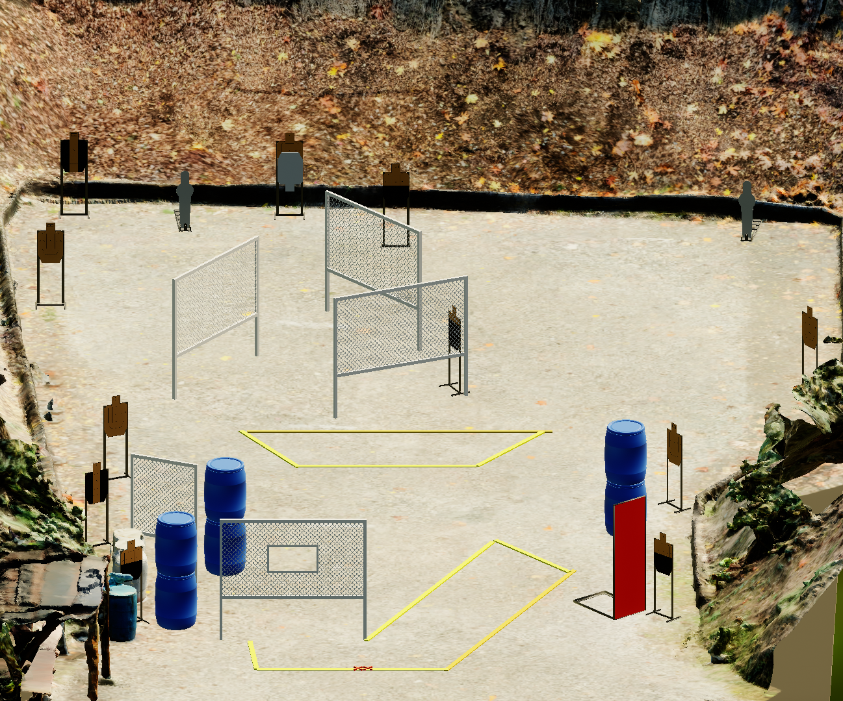
 | Stage 1 Tropical Trauma Course Designer: Jordan Rogers

